Slide 1
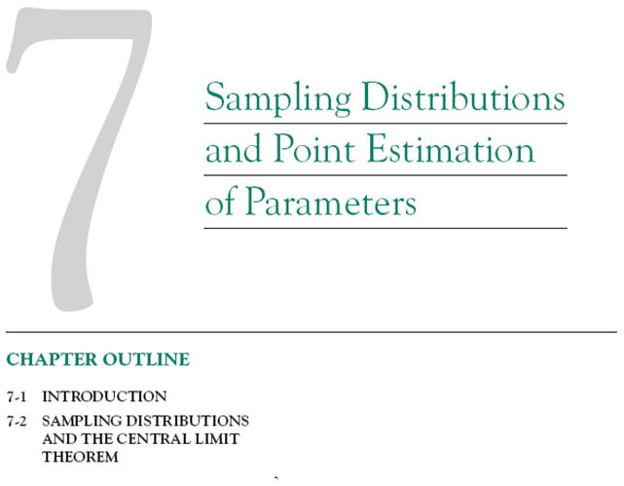

Slide 2
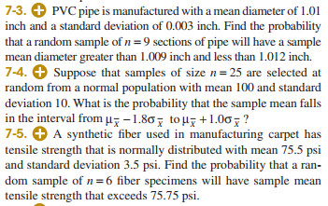

Slide 3
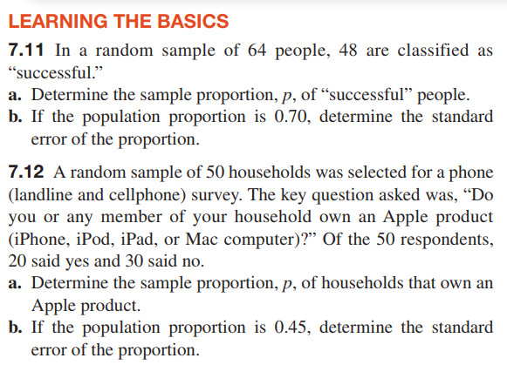

Slide 4
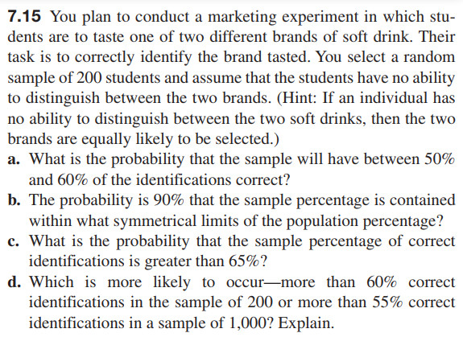

Slide 5
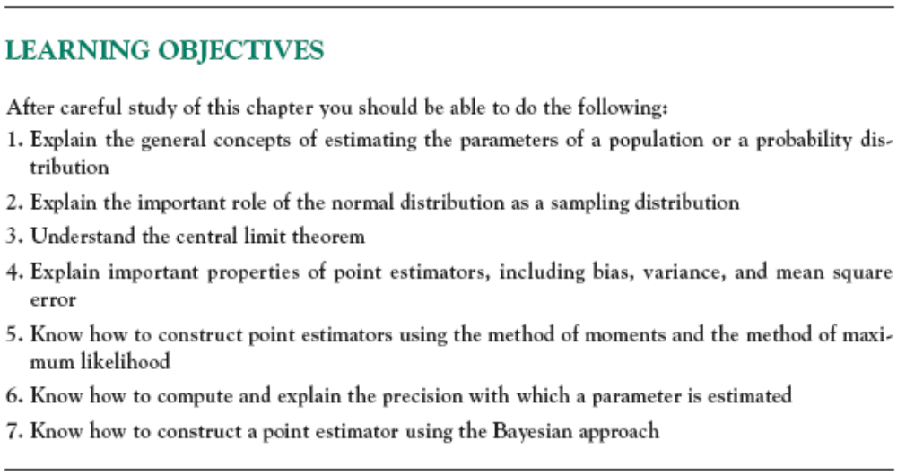

Slide 6
7-1 Introduction
The field of statistical inference consists of those methods used to make decisions or to draw conclusions about a population.
These methods utilize the information contained in a sample from the population in drawing conclusions.
Statistical inference may be divided into two major areas:
  Parameter estimation
  Hypothesis testing
Notes:
utilize: sử dụng

Slide 7
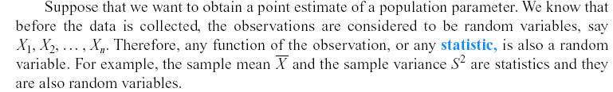

7-1 Introduction
Definition

Slide 8
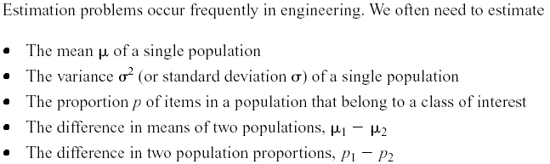
7-1 Introduction

Slide 9
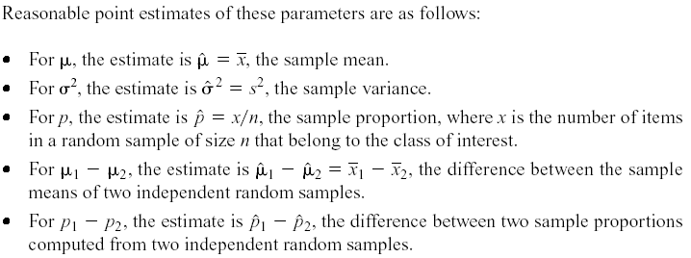
7-1 Introduction

Slide 10
7-1 Introduction
Example
There are two ponds containing lots of fish, a random sample of 20 fish were selected from each pond and record their weight. The results are as follows:
S1: 1.2, 3.0, 2.3, 1.0; 1.9; 2.1; 1.4; 2.2; 0.7; 1.3; 0.5; 0.8; 2.3; 3.3; 4.1; 3.5; 2.7; 1.3; 3.0; 1.4.
S2: 1.0, 2.3, 1.3; 1.5; 0.3; 1.6; 2.3; 2.6; 3.3; 4.2; 0.8; 2.8; 3.7; 0.5; 4.1; 3.3; 2.1; 3.6; 1.8; 2.1
1) Estimated average weight, variance, standard deviation and standard rate of fish (weight> 2 kg) in each pond.
2) Compare the weight average, variance, standard deviation of the number of fish in two ponds and the standard rate of fish in two ponds.

Slide 11
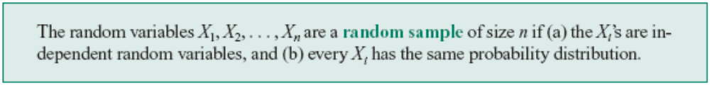
7.2 Sampling Distributions and the Central Limit Theorem
Statistical inference is concerned with making decisions about a population based on the information contained in a random sample from that population.
Definitions:

Slide 12
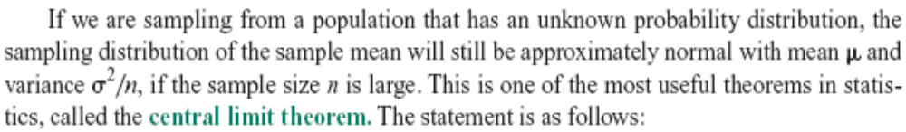
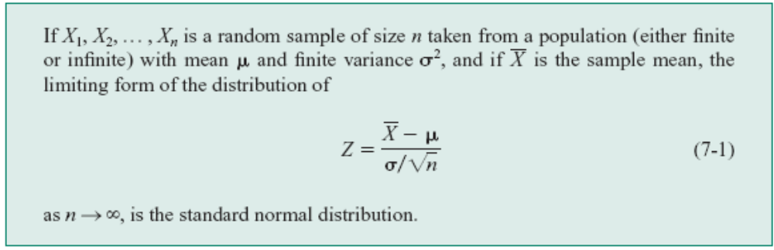
7.2 Sampling Distributions and the Central Limit Theorem
Notes:
Sampling:lay mau

Slide 13
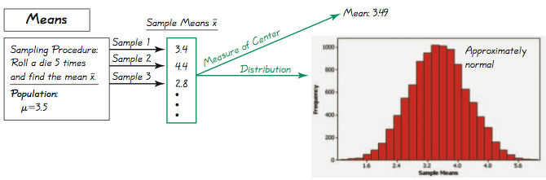
Example - Sampling Distributions
Specific results from 10,000 trials
All outcomes are equally likely so the population mean is 3.5; the mean of the 10,000 trials is 3.49. If continued indefinitely, the sample mean will be 3.5. Also, notice the distribution is “normal.”

Slide 14
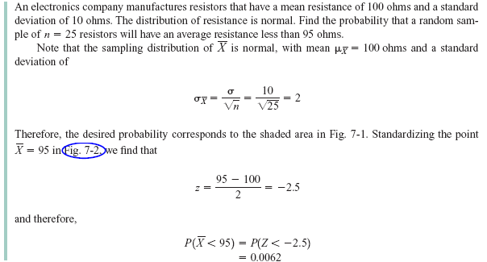
7.2 Sampling Distributions and the Central Limit Theorem
Example 7-1
Notes:
Resistor: điện trở

Slide 15

7.2 Sampling Distributions and the Central Limit Theorem
Figure 7-2 Probability for Example 7-1

Slide 16
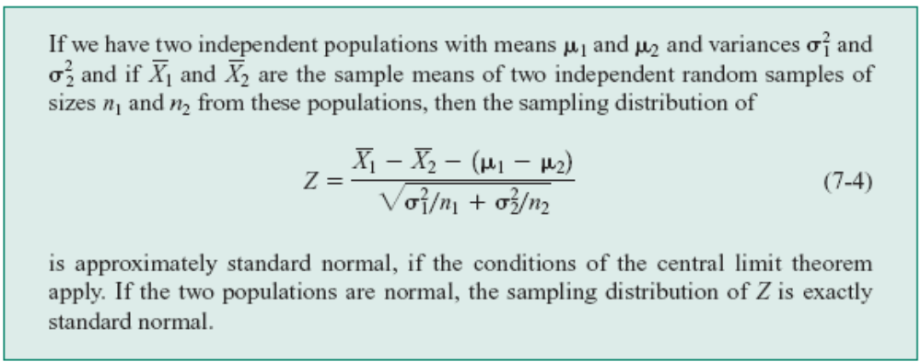
7.2 Sampling Distributions and the Central Limit Theorem
Approximate Sampling Distribution of a Difference in Sample Means

Slide 17
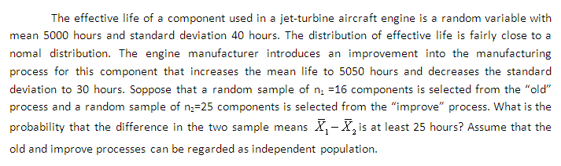

Slide 18
Assume the population of weights of men is normally distributed with a mean of 172 lb and a standard deviation of 29 lb.
Example – Water Taxi Safety
Find the probability that if an individual man is randomly selected, his weight is greater than 175 lb.
Find the probability that 20 randomly selected men will have a mean weight that is greater than 175 lb (so that their total weight exceeds the safe capacity of 3500 pounds).

Slide 19
